Slide 1
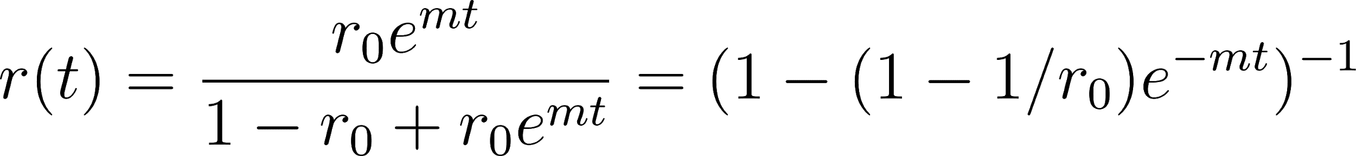
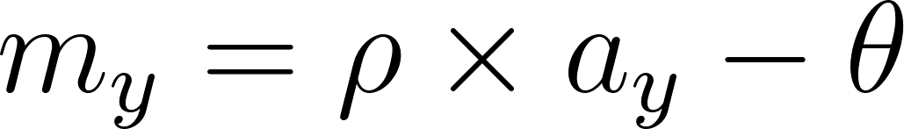
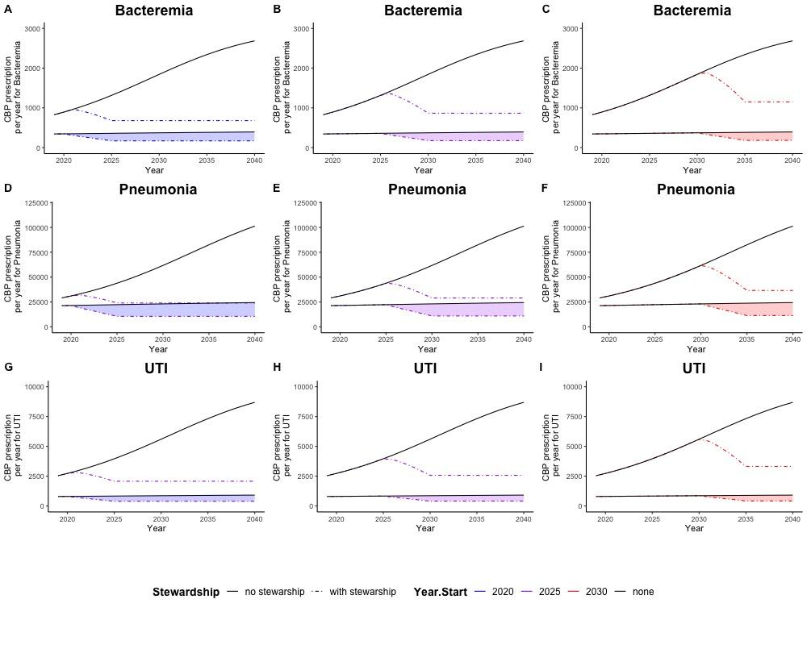
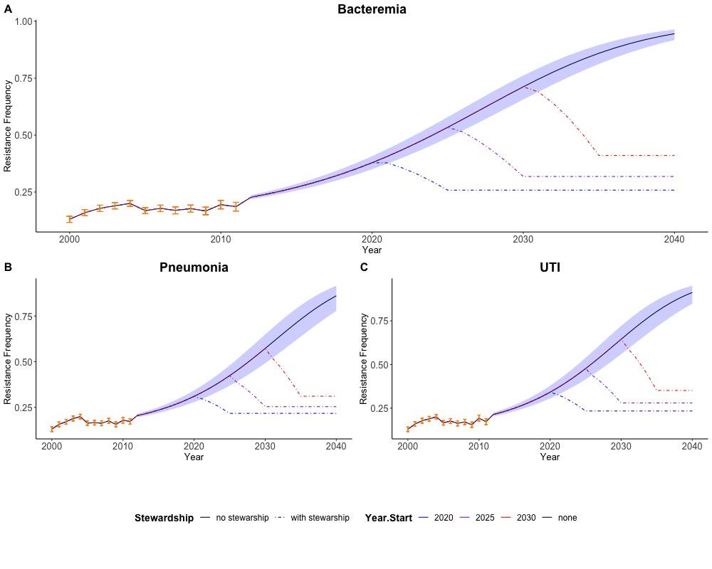


The impact of stewardship on the evolution of carbapenem resistance in Acinetobacter baumannii in the USA
Jorge Alfaro-Murillo, Yiziying Chen, Amber Tang, David Hewitt, Abhishek Pandey, Eric Foster, Eric Sarpong, Sanjay Merchant, Anand Prabhu, Dilip Nathwani, Meagan C. Fitzpatrick, Alison P. Galvani, Jeffrey P. Townsend
Rising levels of carbapenem resistance (CR) are a pressing public health concern in the United States. CR Acinetobacter bacteria in particular are considered a public health threat that requires aggressive and urgent action. Therapeutic alternatives to carbapenems are limited. Implementation of antimicrobial stewardship programs (AMSP) on inappropriate antibiotic use can minimize selection pressure for resistance. Formulary restriction is one strategy used by AMSP. We developed a Malthusian population-genetic model of selection for CR for Acinetobacter baumannii in the US.
Methods:
Increases in CR were modeled as a consequence of inappropriate prescription. Inappropriate prescription was estimated from a retrospective cohort study of inappropriate empiric treatment and future projections were based on historical resistance frequencies and yearly carbapenem consumption associated with A. baumannii. We projected peak A. baumannii CR frequencies, hospitalized cases, deaths and medical costs from 2020–2040. We compared scenarios without any carbapenem restriction to those in which carbapenem usage was decreased linearly to a goal inappropriate use by 2040 starting in 2020 (early) or 2030 (late).
Model Building:
For a given pathogen, the resistance frequency at time t, r(t), starting at initial frequency r₀ can be modeled as,
where m is the Malthusian selection coefficient (Hartl and Clark 2007; Johnsen et al. 2011).
Selective pressure from inappropriate antibiotic prescription increases the relative fitness of resistant bacteria (Austin, Kristinsson, and Anderson 1999), therefore we assume that the selection coefficient m is time dependent,
where ⍴ is a fitted parameter that conveys the degree to which selection is affected by counter-productive prescription, a_{y} quantifies the amount of counter-productive prescription for the year y, and θ is the difference between the exponential growth rate of susceptible bacteria and the exponential growth rate of resistant bacteria in the absence of antibiotics.
Resistance per year (r_{y} for the year y) can be computed recursively
where y = y₀ + n, n is a natural number, y₀ represents the initial year, the time t = 0 corresponds to the first day of the year y₀, the time unit is years, and r_{y} is measured at the middle of the year y.
Results:
Figure 2. Overall and inappropriate CBP prescription across US under status quo (grey solid line) and under stewardship interventions beginning in 2025 (dot-dashed blue line), 2030 (dot-dashed purple line), and 2035 (dot-dashed red line) to treat a A. baumannii infection causing A–C) bacteremia, D–F) pneumonia, and G–I) UTI, implemented in A, D, G) 2025, B, E, H) 2030, or C, F, I) 2035, projected assuming constancy of the 2011 prevalence of pneumonia, bacteremia, and UTI (HCUP), and of levels of carbapenem prescriptions (CDDEP).
Table 1. Projected resistance frequencies among A. baumannii cases in 2040.
Stewardship start year | Bacteremia | Pneumonia | UTI
never | 86.0% | 75.6% | 89.6%
2020 | 23.2% | 19.9% | 23.6%
2025 | 28.7% | 23.5% | 30.1%
2030 | 36.6% | 28.6% | 39.4%
Figure 1. Observed resistance frequencies and 95% confidence intervals (orange circles and error bars) spanning 2000–2011, and model fit (black line) and 95% confidence interval (blue bands) for projected carbapenem resistance frequencies spanning 2000–2045, and observed frequencies (orange points) among A. baumannii cases with A) bacteremia, B) pneumonia, and C) UTI under status quo.
Table 2. Prevented cases of carbapenem-resistant A. baumannii infection in the US between 2025–2045
Stewardship start year | Bacteremia | Pneumonia | UTI
2020 | 29,600 | 1,051,600 | 110,300
2025 | 23,500 | 867,000 | 88,600
2030 | 15,200 | 600,000 | 58,700
Conclusion:
Antibiotic resistance is a critical issue in public health and individual medicine, even though those two arenas can have opposing means towards achieving their unified goal of improving health. Empiric therapy, while expeditious in resolving an individual patient’s disease, actively works against public health, by driving up the prevalence of drug resistance in patient and community populations. Our study establishes, for the first time, spatially-averaged national-scale impacts of antibiotic stewardship programs that are developed to balance these goals.
Effective antibiotic stewardship works to reduce drug resistance, and our model predicts that drug resistance will increase further, as stewardship programs continue to be in place. We find that early establishment of stewardship programs is the most effective means of assuring that antibiotic resistances in the population is reduced, without wholly removal the critical need for early use of carbapenem in A. baumannii bacteremia, pneumonia, and UTI cases.
Parameterization and Model Fitting
References:

